Slide 1

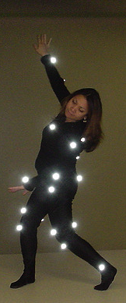
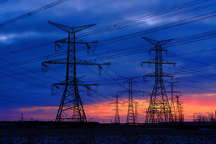
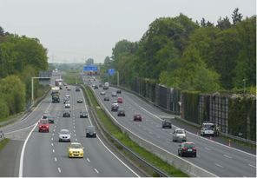
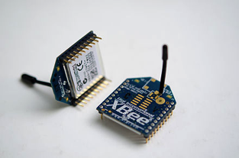
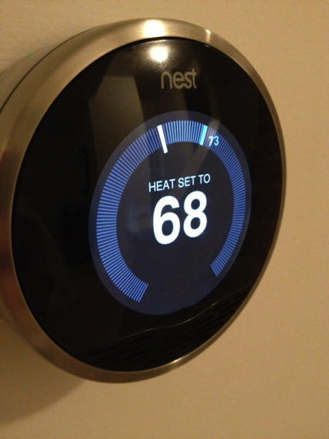
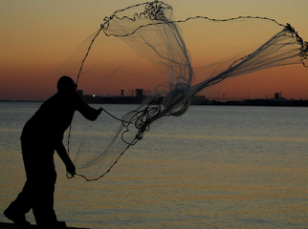
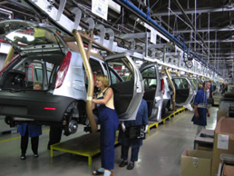
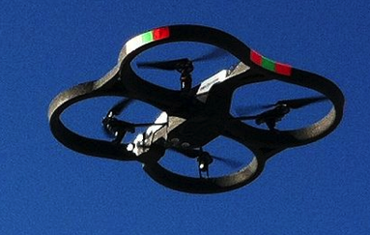
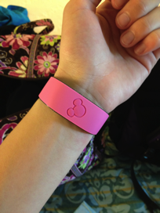
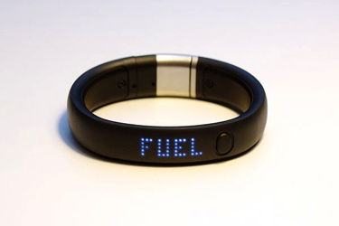
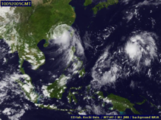
Data, Big Data and real time analytics for Connected Devices
Srinath Perera, Ph.D.
Director of Research
WSO2 Inc.

Slide 2
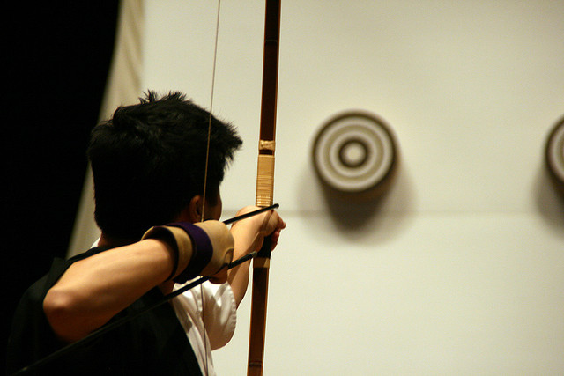
Outline
IOT
Why Bigdata?
A reference Architecture
Technologies
Usecases
Photo by John Trainoron Flickr http://www.flickr.com/photos/trainor/2902023575/, Licensed under CC

Slide 3
Internet of Things
Currently physical world and software worlds are detached
Internet of things promises to bridge this
It is about sensors and actuators everywhere
In your fridge, in your blanket, in your chair, in your carpet.. Yes even in your socks
Google IO pressure mats

Slide 4
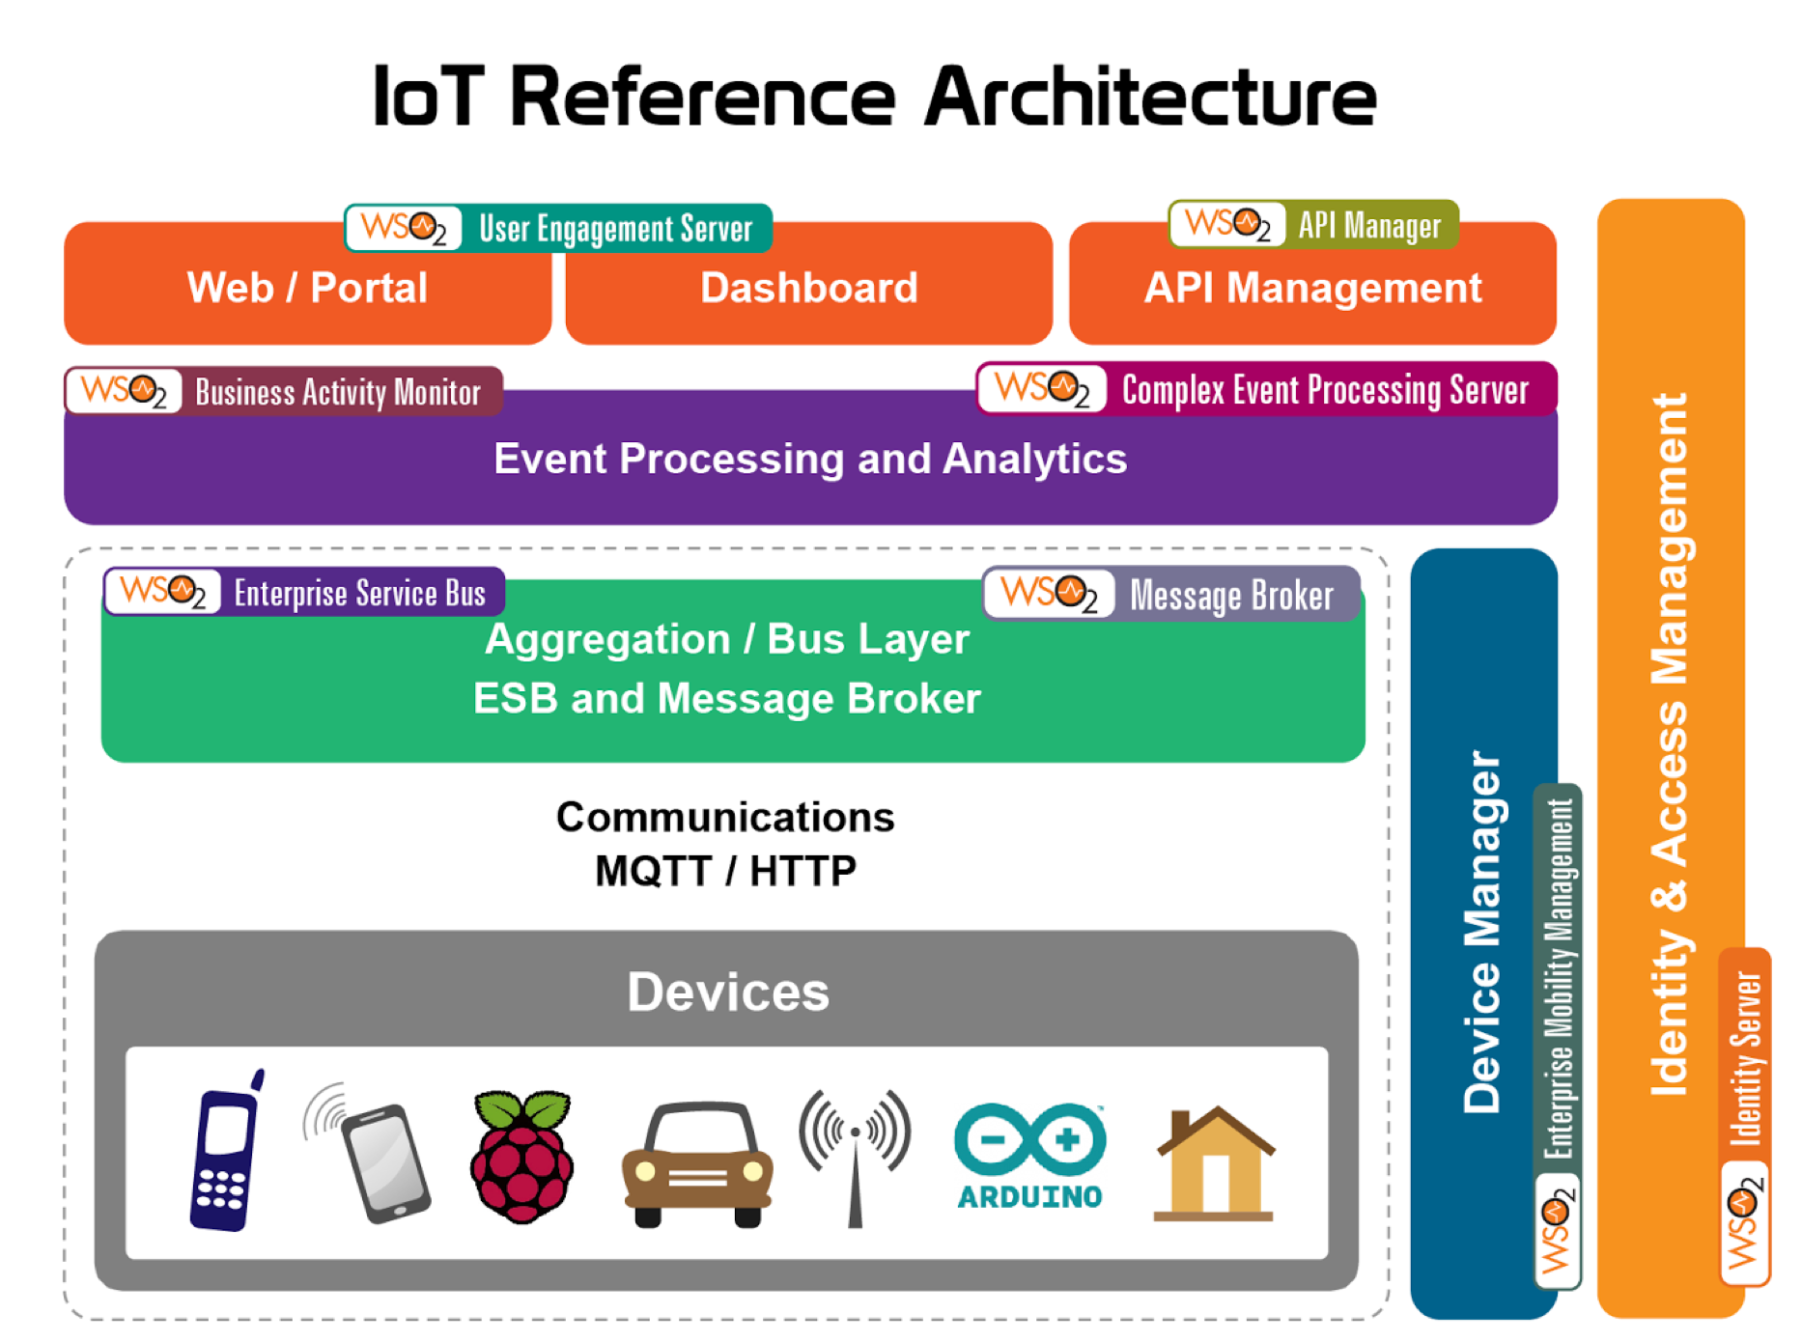

Slide 5
IoT Usecases
Smart Home - energy optimization (e.g. control temperature), hostspot reporting, home surveillance, smart lighting, perimeter checks for pets, kids
Smart health - personal tracker, in home care
Agriculture - water based on moisture level, pest control, live stock management
Smart city - waste management, parking, traffic, pollution monitoring, smart bridges/ constructions - put lot of sensors in to concrete .
Smart buildings - energy, surveillance, elevators,
Smart retail, smart logistics, smart manufacturing etc.

Slide 6
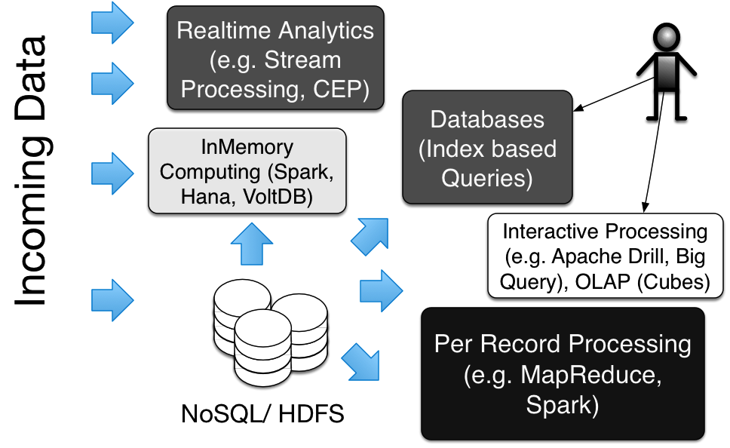
Data Processing Tools Landscape

Slide 7
Lot of focus on hardware side, making connection etc. What it take to make good decisions based on data?

Slide 8
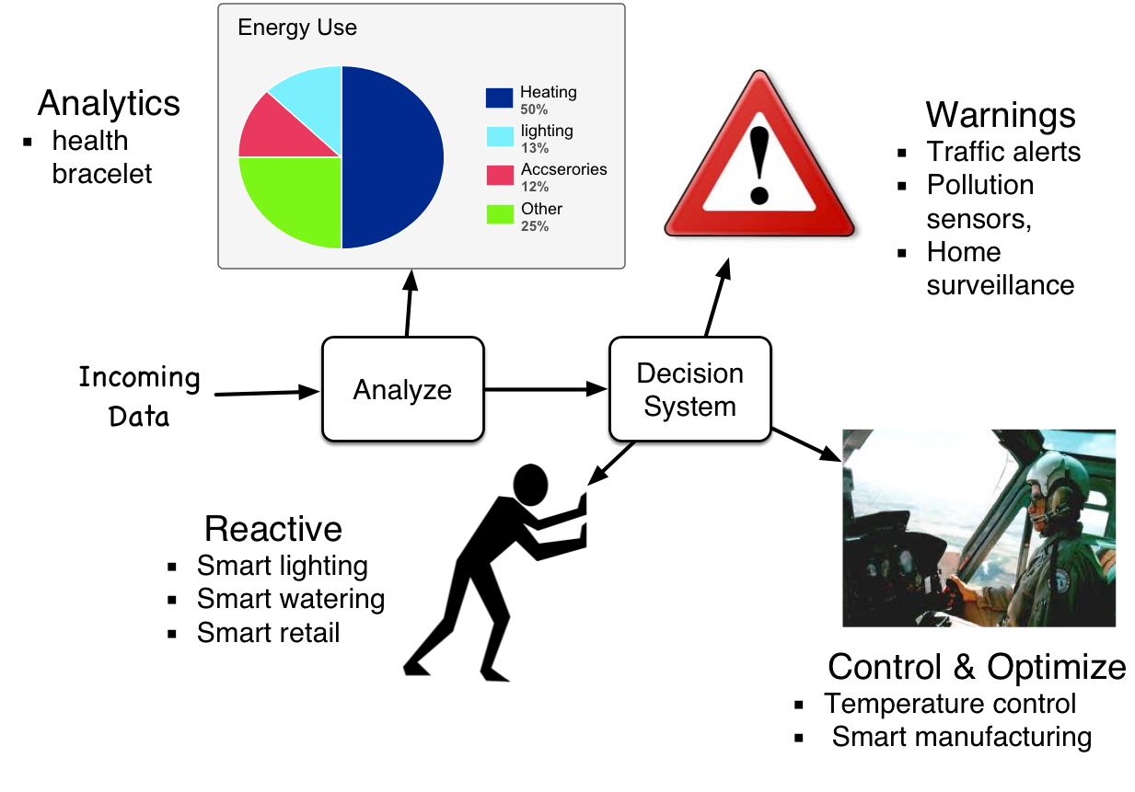
IoT Usecases by Decision Models

Slide 9
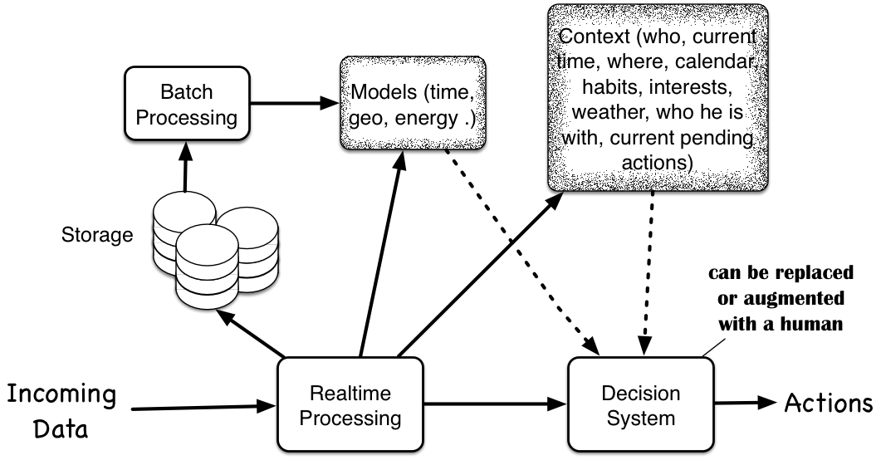
Decision Model for IoT

Slide 10
Design Considerations
Edge processing - local processing onsite for efficiency and HA
Last mile – how to push actions. How to carry out a action that takes time and avoid conflicts
Integration with the world - Calendar, understanding for the context, using other services and data
Most decisions falls into broad classes - prediction, anomaly detection, optimization
Support for context - who, current time, where, calendar, habits, interests, weather, who he is with, current pending actions

Slide 11
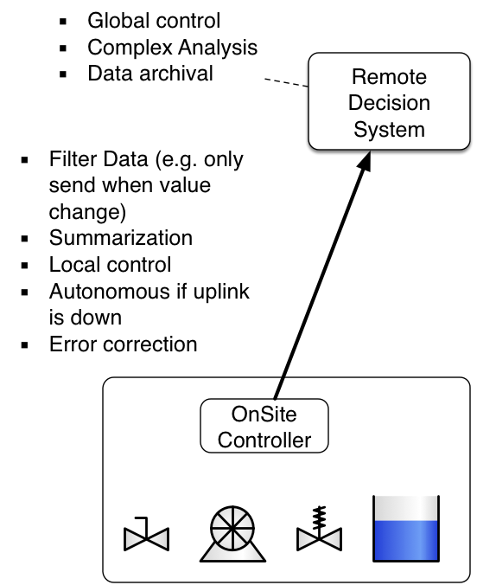
Edge Processing
First solutions suggest decisions are placed in the cloud
Have to send all data to cloud? May be too much
What if cloud or connection failed?
Latency
However, better models and decision are possible using data from many sites
*WSO2 CEP can also run in the edge

Slide 12
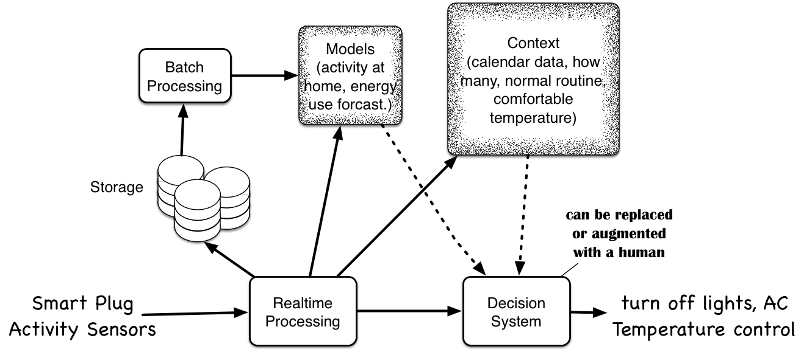
Smart Energy as an Example

Slide 13
Taking Human Out of the loop
Need to be done carefully as we do not foresee possible outcomes
Gradually with fine grain control
Provide alarms, and give potential actions
Ask user to confirm actions
Only automate selected actions – e.g. once user OK every time, let user control at each action level.

Slide 14
Tools for Building Decision systems for IoT

Slide 15
What you need from tools?
Realtime processing
Process streams without storing
Temporal queries
Low latency
Complex Event Processing Systems are a great match (e.g. WSO2 CEP)
Batch processing
Basic analytics, MapReduce or Spark
Decision system
Reason with many facts
Derive inferences
Often done with a rule based system (e.g. WSO2 Rules Server/ Drools, Prolog)

Slide 16
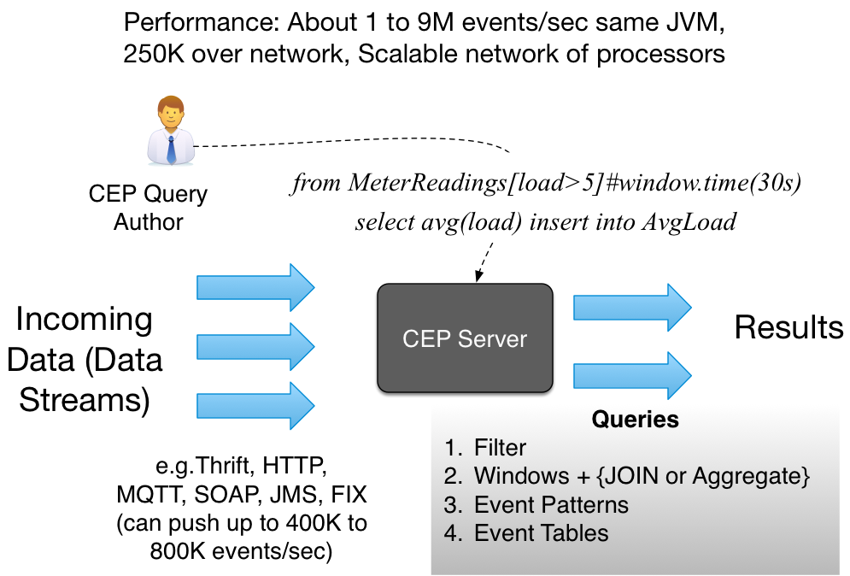
WSO2 Complex Event Processor

Slide 17
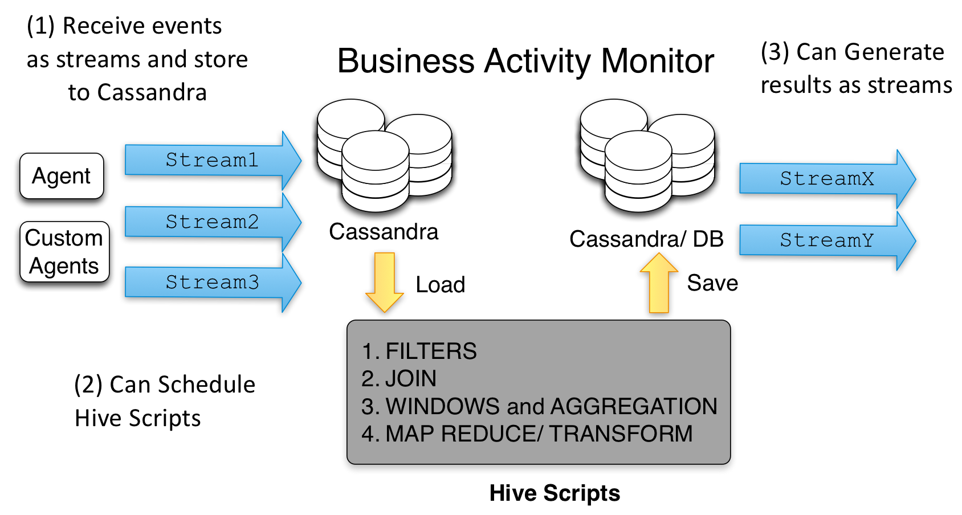
Business Activity Monitor

Slide 18
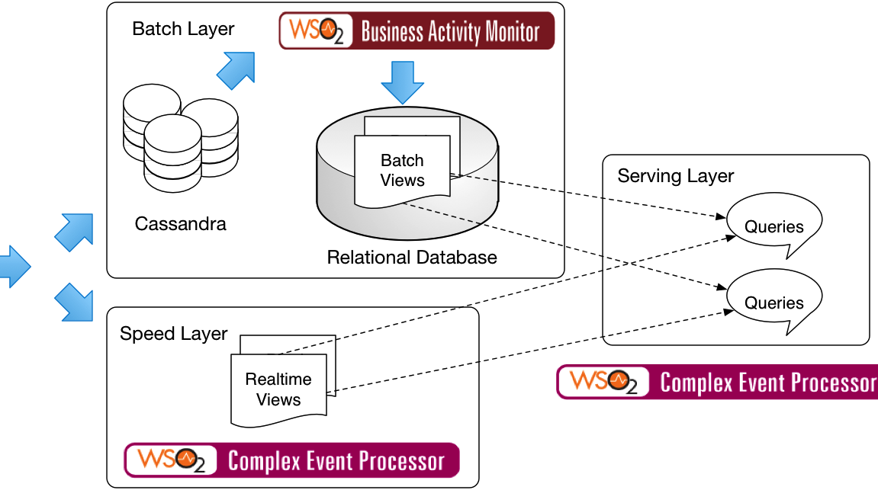
Lambda Architecture

Slide 19
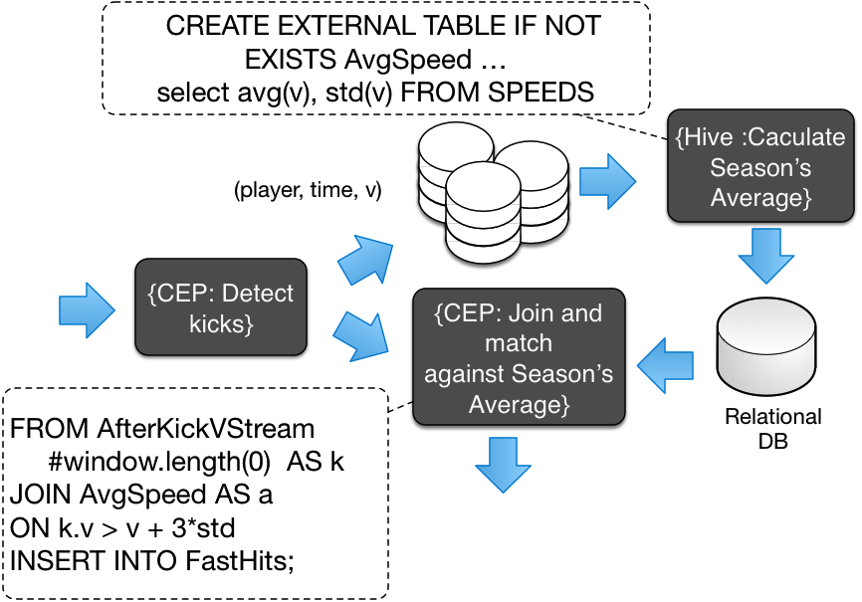

Slide 20
Other Products useful in IoT context
WSO2 Business Rule Server – support rule execution based on Drools
WSO2 ESB for integrating with other systems
WSO2 User Engagement Server (UES) to build dashboards
WSO2 EMM for device management
WSO2 API Manager to expose APIs

Slide 21
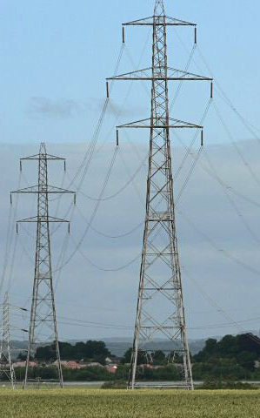
Case study: Smart Energy
DEBS (Distributed Event Based Systems) is a premier academic conference, which post yearly event processing challenge
Smart Home electricity data: 2000 sensors, 40 houses, 4 Billion events
WSO2 CEP based solution is one of the four finalists (Others Dresden University of Technology and Fraunhofer Institute (Germany), and Imperial College London)
We posted fastest single node solution measured (400K events/sec) and close to one million distributed throughput.

Slide 22

Case study: Realtime Soccer Analytics
Video in https://www.youtube.com/watch?v=nRI6buQ0NOM

Slide 23
Conclusions
Understanding IoT
IoT architecture and design
IoT Decision systems
Tools and design choices
Conclusion

Slide 24
Questions?

